Slide 1

Trauma Healing Services
Presentation by: Liesl Lang, LPC (Program Manager)

Slide 2
Mission of THS
To provide compassionate, trauma-informed, culturally sensitive, LGBTQ affirming, age-appropriate, gender-responsive services to anyone whose life has been touched by sexual or domestic violence or other crimes regardless of financial or immigration status.

Slide 3

Our Approach Toward Clients
Everyone is doing the best they can
Clients are the experts
Their approach has helped them survive
Victims are courageous for reaching out for help
Safety is built through respectful care
It is an HONOR to serve

Slide 4
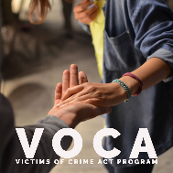
ALL VOCA-Funded Victimization Types & ALL Ages Served
Most Common:
Adult Sexual or Physical Assault
Adults Sexually Abused/Assaulted as Children
Child Physical or Sexual Abuse or Neglect
Domestic Violence
Sex Trafficking
Stalking
Survivors of Homicide Victims
Bullying

Slide 5
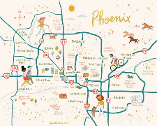
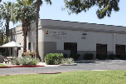

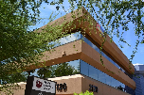
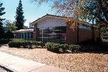

Locations
Tempe office
Glendale office
Co-location at the Phoenix Family Advocacy Center
Telehealth
Co-location at New Life Center’s Sunshine Healing Services

Slide 6




Services Provided
24-Hour Hotline
Community Outreach and Training
Individual/Family/Group Therapy
Take Back the Night
Victim Advocacy and Resource Connection

Slide 7

24-Hour Hotline
Rape Abuse Incest National Network
Arizona calls are answered by EMPACT-SPC
480-736-4949
1-800-656-HOPE
Two lines
Local THS Hotline

Slide 8

Crisis Intervention
Risk assessment
Stabilization of high intensity symptoms
Psychoeducation
Assistance with filing police reports and orders of protection
Coordination of sexual assault nursing exams and other immediate needs

Slide 9
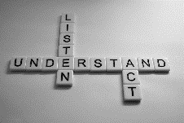
Victim Advocacy and Resource Connection
Assessment of Immediate and Long-Term Needs
Coordination of care
Connection to resources
Assessment of stability and fit for services
Victim Assistance
Interventions with employers, schools, housing, etc

Slide 10

Weekly Individual and Family Therapy
Up to 20 sessions
Offered in English or Spanish
Evidence-based treatments
Trauma-Focused

Slide 11

3 Phases of Healing
Safety and Stabilization
Processing Trauma
Reconnection and Integration

Slide 12

A safe and supportive relationship with a compatible therapist is the most important element of therapy.
Therapy is most successful when a genuine human connection is built.

Slide 13

Weekly Individual & Family Therapy: Evidence-Based Treatments
EMDR
Trauma-Focused Cognitive Behavior Therapy
Dialectical Behavior Therapy
Internal Family Systems Therapy
Motivational Interviewing
Brainspotting
Cognitive Processing Therapy
Mindfulness-based interventions
Heartmath
Family Systems Trauma Model
Sensorimotor
Sand Tray Therapy
Play Therapy
Acceptance and Commitment Therapy
MORE

Slide 14
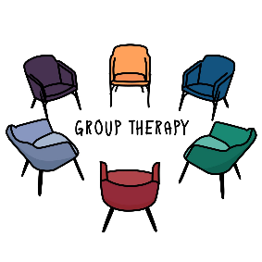
Weekly Group Therapy
Crisis Survival Skills / Trauma Releasing Exercises
Trauma-Informed Parenting
Trauma-Informed Yoga
Men’s Support Group
Dialectical Behavior Therapy (for Adults and Adolescents)
Women’s Support Group
ASU Sexual Violence Support Group

Slide 15
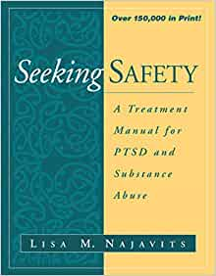
Adult Crisis Survival Skills Group
Clients learn how to:
Manage trauma symptoms
Cope in healthy ways, without use of self-destructive behavior
Take good care of themselves
Find safe people who can be supportive
Free themselves of abusive relationships
Find ways to feel good about themselves and enjoy life
English or Spanish Options
Based on the Seeking Safety curriculum
Trauma Releasing Exercises

Slide 16
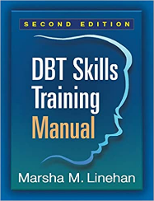
Dialectical Behavior Therapy Skills Group
Adult and Adolescent Groups
Clients learn:
Mindfulness
Interpersonal Effectiveness
Distress Tolerance
Emotion Regulation

Slide 17
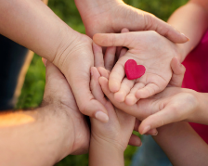
Trauma-Informed Parenting Group
Attended by guardians and their children
Topics covered:
Trauma and Child Development
Building Safety
Addressing Feelings and Behaviors
Connecting and Healing
Trauma-Informed Co-Parenting and Parallel Parenting
Becoming an Advocate
Self-Care

Slide 18

Trauma-Informed Yoga Group
Designed to help adult survivors re-establish a safe connection with the physical body, re-set the nervous system, and cultivate empowerment and choice

Slide 19
Support (Processing) Groups
3 Types: Men’s Group, Women’s Group, ASU Sexual Violence Group
Psychoeducation and processing around various topics: self-compassion, dealing with lasting triggers, healthy sexuality, shame, exploring values and identity, healthy boundaries and relationships, meaning-making, creating the future

Slide 20

Sex Trafficking Awareness and Recovery Group
For adult sex trafficking survivors
Psychoeducation about trafficking, trauma bonds, and cycle of violence
Exploring family roles, family secrets, and types of familial abuse
Exploring grief and trauma
Establishing healthy boundaries
Exploring Values and Identity
Addressing self-harm

Slide 21

Community Outreach & Training
Attendance at tabling events and community collaborative meetings
Free community presentations
Internship programs for Bachelor, Masters, and Doctoral Level Students

Slide 22

Take Back the Night Phoenix
Annual awareness event for SV/DV co-hosted with Arizona State University

Slide 23

Common Questions
How do I refer a survivor?
Have them call our 24-hour hotline at 480.736.4949
How can I get involved with Take Back the Night or THS?
Email Liesl.Lang@LaFrontera-EMPACT.org

Slide 24

Thanks for listening and supporting survivors!
Q&A

