Slide 1
An ADHS Update on
Opioid Overdose Data Trends
December 2, 2021
Sheila Sjolander, Assistant Director, Prevention Services

Slide 2
More than 5 Arizonans a day died from opioids last year
Total Opioid Deaths
Rx/Synthetic Deaths
Heroin Deaths
Notes:
45% increase

Slide 3
Similarly, the monthly number of opioid deaths reached a peak in mid-2020, followed by a decline, but has increased again in 2021.
Data Source: Death Certificates (July 2019- June 2021), n=3,782
*Data for 2020 and 2021 is provisional and subject to change
Notes:
*Data Source: Death Certificates (July 2019- June 2021), n=3,782
*Please note that data for 2020 and 2021 is provisional and subject to change
As of 11/29/21 Arizona has had 1,554 opioid deaths, including 83 heroin deaths. Deaths involving all drugs total 2,237 in 2021.

Slide 4
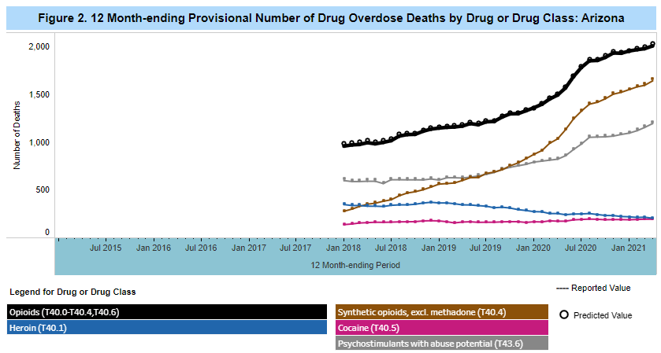
CDC 12 Month-ending Provisional Drug Overdoses
As of April 2021:
2,005 deaths involving opioids
1,192 deaths involving psychostimulants
In prior 12 months
Total Number of Reported Overdose Deaths in Past 12 Months in Arizona
April 2020: 2,146
April 2021: 2,743
Source: https://www.cdc.gov/nchs/nvss/vsrr/drug-overdose-data.htm
Notes:
https://www.cdc.gov/nchs/nvss/vsrr/drug-overdose-data.htm

Slide 5
The rate of opioid deaths per 100,000 residents was higher in 2020 than in 2019 for all counties except Yuma. Highest rates are in Maricopa, Pima and Yavapai counties.
2019
2020
Data Source: Death Certificates, 2019-2020

Slide 6
Two-thirds of verified fatal and non-fatal opioid overdose events were among people aged 15-44, with 30% of overdose events among 25-34 year-olds.
Notes:
*Data Source: MEDSIS, July 2019- June 2021 (n=10,694)
**The numbers presented in the graph are slightly different than the data presented on the external dashboard, which uses additional data sources and different filtering criteria.
^{ⴕ}Missing values for age group were excluded from this graph.

Slide 7
Similarly, two-thirds of opioid deaths were among people aged 15-44, although there was a lower proportion of fatalities among 15-24 year-olds.
Notes:
*Data Source: Death Certificates, Jan 2019- Nov 2021 (n=4,866)
**Please note that data for 2020 and 2021 is provisional and subject to change

Slide 8
From Arizona Child Fatality Review
In 2019
Of the 30 poisoning deaths, 28 deaths involved opioids and 27 of opioid deaths involved fentanyl
In 2020
Of the 52 poisoning deaths, 51 were opiate overdoses and fentanyl was responsible for 50 poisonings
Number of Substances Found as a Contributing Factor to the Death of a Child by Deceased Child User or Other Child or Adult User, Ages 0-17 Years, Arizona, 2020

Slide 9
White, non-Hispanic individuals accounted for 57% of opioid deaths.
Data Source: Death Certificates, Jan 2019- Aug 2021 (n=4,866)
Notes:
*Data Source: Death Certificates, Jan 2019- Nov 2021 (n=4,866)
**Please note that data for 2020 and 2021 is provisional and subject to change

Slide 10
Fentanyl and Oxycodone are the most common substances involved in verified fatal and non-fatal opioid overdose events in the last two years.
Data Source: MEDSIS, July 2019- June 2021
Notes:
*Data Source: MEDSIS, July 2019- June 2021
**The numbers presented in the graph are slightly different than the data presented on the external dashboard, which uses additional data sources and different filtering criteria.
^{ⴕ}The above charts count the drug type(s) used, not the number of people. One person can be counted in more than one drug type if they used multiple drugs.
Denominator: Total number of verified opioid overdose events (n=10,701)
On ADHS dashboard, 55.7% of overdoses involved fentanyl in 2021 as of Nov. 22

Slide 11
Pre-hospital/emergency medical services (EMS) responses for suspected opioid overdoses increased in 2020. Monthly responses have fluctuated but remained relatively constant since then.
Data source: AZPIERS (Arizona Pre Hospital Information and EMS Registry System)
July 2019- June 2021
Notes:
*Data source: AZPIERS (Arizona Pre Hospital Information and EMS Registry System) July 2019- June 2021, n=35,956

Slide 12
Naloxone administered by law enforcement personnel during suspected opioid overdose responses gradually increased until mid-2020, with ongoing fluctuations since then.
Data source: AZPIERS (Arizona Pre Hospital Information and EMS Registry System)
July 2019- June 2021. n=2,748
Notes:
*Data source: AZPIERS (Arizona Pre Hospital Information and EMS Registry System) July 2019- June 2021. n=2,748

Slide 13
Coming soon:
An updated website: azhealth.gov/opioid
State Unintentional Drug Overdose Reporting System (SUDORS) – Reports from ASU
Questions/Comments: azopioid@azdhs.gov
sheila.sjolander@azdhs.gov

