Slide 1

ABUSE AND THE OLDER ADULT
November 14, 2023
©2023 Area Agency on Aging, Region One, Inc.

Slide 2
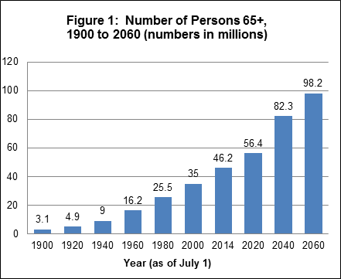
Aging in America
©2023 Area Agency on Aging, Region One, Inc.

Slide 3
What is Abuse?
Defined as a pattern of behavior that includes the use or threat of violence and intimidation for the purpose of gaining power and control over another person
Sexual abuse is “non-consenting sexual contact of any kind”
– It is not about SEX but is about POWER & CONTROL!!
National Center on Elder Abuse,1998
©2023 Area Agency on Aging, Region One, Inc

Slide 4
Difference
Elder Abuse is the abuse, neglect, or financial exploitation of a vulnerable adult, usually by a family member or caregiver.
  VS
Domestic Violence is the emotional, financial, physical, or sexual abuse by an intimate partner where the abuse is used to exercise power and control.
©2023 Area Agency on Aging, Region One, Inc.

Slide 5
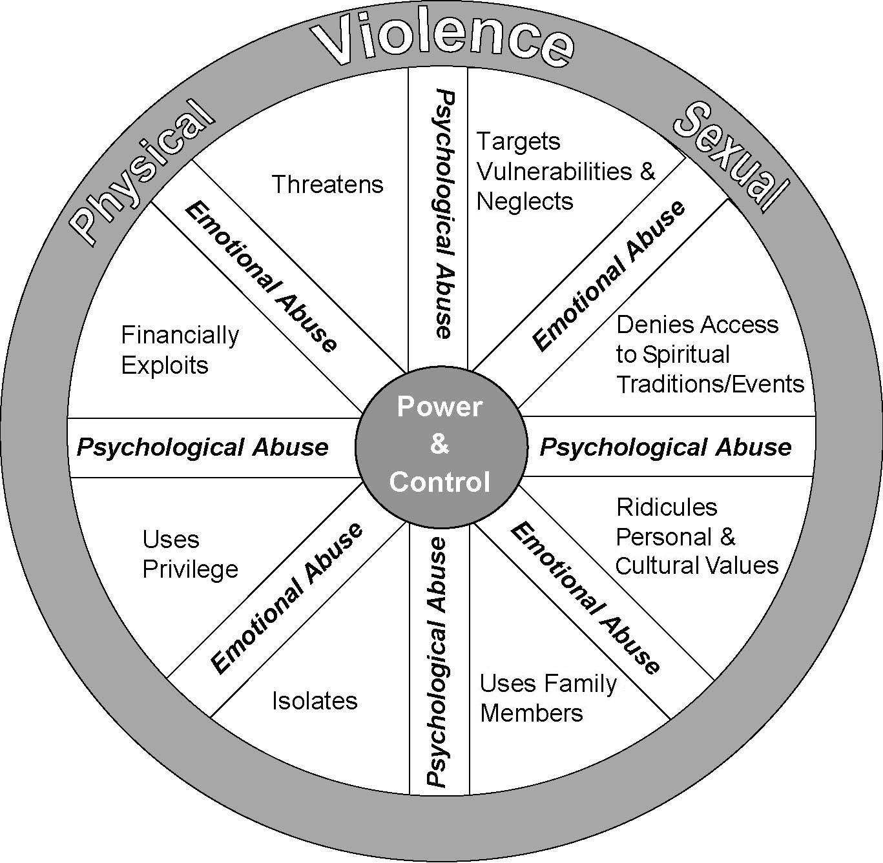
Older Victims Power & Control
NCALL, 2011
©2023 Area Agency on Aging, Region One, Inc

Slide 6
Scope of the Issue
Up to 5 million seniors suffer from abuse every year. (NCOA
2021)
Americans aged 65 and older are more likely to be targeted and 35% more likely to lose money once targeted than respondents in their 40s. (FINRA 2018)
  $50 billion per year lost to fraud.
1 in 4 women and 1 in 7 men experience abuse in their lifetime. (NCADV 2017)
Older women are 6 times more likely than older men to be
sexually assaulted
  18% of women raped each year are sixty years of age or older.
  Less than 1% of elder sexual assault cases are reported and substantiated
©2023 Area Agency on Aging, Region One, Inc.

Slide 7
Unique Issues Older Adults of DV May Have
Isolation
  Less likely to have strong support system
Many do not identify as being controlled or abused
Strong belief that abuse will end (abuser’s behavior will change)
Financially dependent
Social and cultural values
Guilt and Shame
Religion
Fear of being alone/Fear of placement
NCALL, OVW (2017)
©2023 Area Agency on Aging, Region One, Inc.

Slide 8
Barriers to Reporting
Victims don’t seek services
Reluctant to report due to shame/credibility
Clinicians under-recognize signs of abuse
Signs are attributed to normal aging process
Victim may have cognitive/physical limitations that impede reporting
Perpetrator blocks access to reporting
Burgess, Ann (2006)
©2023 Area Agency on Aging, Region One, Inc

Slide 9

DOVES Program
Community Program:
  Mobile Advocacy
  Community Support Groups
  Outreach (Prevention Education)
  Counseling (partnership with ElderVention)
Transitional Housing
©2023 Area Agency on Aging, Region One, Inc

Slide 10
What can you do to help someone in need?
Listen to their story and believe them
Hold what you are told in confidence
Encourage your friend to think about safety. Help your friend make concrete plans to deal with “what ifs”
Provide information on resources
Respect their choices and limits
©2023 Area Agency on Aging, Region One, Inc

Slide 11
Contact Information
www.aaaphx.org
Senior HELP LINE: (602) 264-4357
©2023 Area Agency on Aging, Region One, Inc

